Slide 1
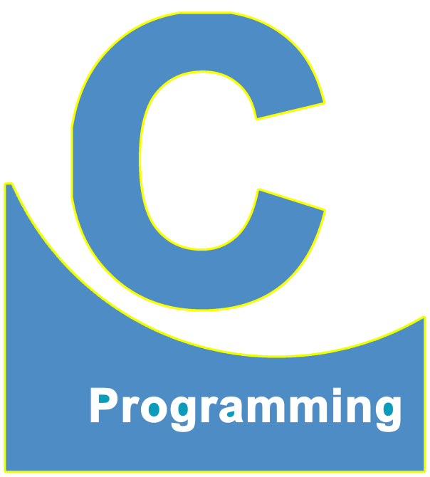
01
02
C Language
Lecture 4
04

Slide 2


Today’s Agenda
01
What are Functions ?
02
Importance of main() Function.
03
Function Definition & Call

Slide 3
What are Functions ?
What are Functions ?
In programming a, function is block of statements having, a particular name
followed by a pair of parenthesis every C program is a collection of one or
more such functions.
Amongst these functions, the most popular is the function main().
This is because

Slide 4
What are Functions ?
#include <stdio.h>
#include <conio.h>
void main()
{
clrscr();
printf();
}
main is a function name and
void is a return type
Function body
We will discuss about void return type in the Function topic.

Slide 5
What are Functions ?
#include <stdio.h>
#include <conio.h>
void main()
{
clrscr();
printf();
}
Block opening Bracket
Compound Statement
Block closing Bracket

Slide 6
Importance of main() Function
Whenever we run a C language program, its execution done by OPERATING SYSTEM and this execution always begins from the function main().
Can we compile a C program without the function main() ?
Yes we can always compile a C program even if it is not having the function main(). But we can never execute it.

Slide 7
Importance of main() Function
This is because Compilation always begins from the FIRST LINE while
execution always begins from the function main().
So, without main() compilation is possible but not execution.
Hence we can say that main() is the ENTRY POINT of execution of
our program

Slide 8
Function Definition & Call
Function
Define
Call
Function definition means just writing the body of a function. A body of a
function consists of statements which are going to perform a specific task.
A function body consists of a single or a block of statements. It is also a
mandatory part of a function.

Slide 9
Function Call
A function call means calling a function whenever it is required in a program.
Whenever we call a function, it performs an operation for which it was designed.
A function call is an optional part in a program.

Slide 10
Function Define
#include <stdio.h>
#include <conio.h>
void main()
{
clrscr();
printf();
}
Here we are defining
the main() function.

Slide 11
Function call
#include <stdio.h>
#include <conio.h>
void main()
{
clrscr();
printf();
}
Here we are calling the
function clrscr() and printf()

Slide 12
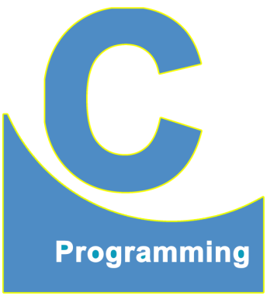
End of Lecture 4
For any queries mail us @: scalive4u@gmail.com
Call us @ : 0755-4271659, 7879165533
Thank you

